Slide 1
Website LLC
Michelle Williams
@mcwilli94 on GitHub

Slide 2
Description
A website created for potential clients, who are looking for an attorney.
Information includes background information on Attorney Williams, past client feedback, contact information, and specific services provided by this law firm.
A separate database exists where the attorney can store, access, edit, and update specific client information.
The data is hidden behind a login screen that requires an administrator’s login information.
An 1-3 sentence elevator pitch version of your project description. What problem does it solve?

Slide 3
Features
Checking posts to ensure each person only posts once.
Checking client input for duplication.
List of reviews and list of clients which can be added to

Slide 4
Planning - User Stories
Created the website since Attorney Williams currently does not have a website available for clients to research information on her.
Useful for clients seeking an attorney well verses in domestic relations and municipal laws in the state of Missouri.
Perfect place for keeping secure information on clients with easy access to the data from anywhere.

Slide 5
Planning - Database
A database for storing the reviews created by past clients, administrator login information, and client information.
Admin functionality available for reviewing, rejecting, and accepting client reviews. Moreover, the administrator is able to access, create, edit, and delete client information. Changing the login information is another feature exclusively available to the administrator. A few changes will be instituted as my client sees and requests different features.
User functionality is limited to posting a comment and review of Attorney Williams’ professional performance.
Describe what tables are necessary in your DB, and how they relate to one another. Your goal is to show how you designed your database to allow for the user stories listed above.

Slide 6
Technology Stack
Java, HTML, CSS
Spring Boot
Thyme Leaf
My SQL
IntelliJ, Security

Slide 7
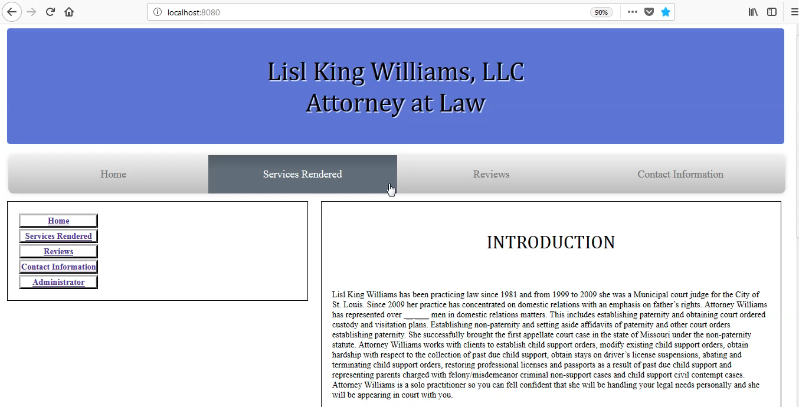
Demo

Slide 8
What I Learned
Google maps
Spring Boot Security
Using sessions with Java
CSS hover command
The importance of making a website visually pleasing and easy to navigate
How user stories work

Slide 9
What’s Next
Email trigger for when someone wants to post a review.
Placing posts in the pending category before adding them to the review database.
List of reviews and list of clients which can be edited or deleted.
Finishing the logout feature.
Finding a server to host the website.
Finishes inputting the information for the different webpages.
Add sorting ability for client list.
Notes:
Be specific! If you mention another feature describe why that features is necessary, or what problem it solves. If you mention changing the UI mention specific technologies, or libraries you will use to do that. If you mention a technology, or feature you don’t know yet tell them how you plan on learning it.

